Slide 1
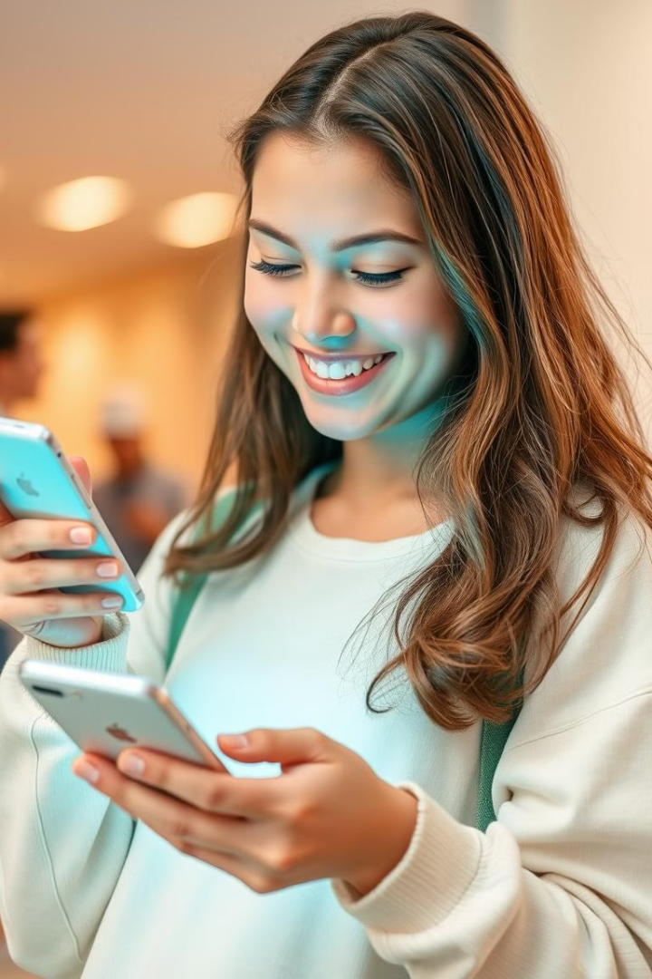
Social Media Security: Level Up Your Privacy
Welcome! Let's make your online life safer and protect your identity, reputation, and privacy. Did you know that 72% of teens use social media daily? Stay safe online!
VN
by Viv Ndung'u

Slide 2
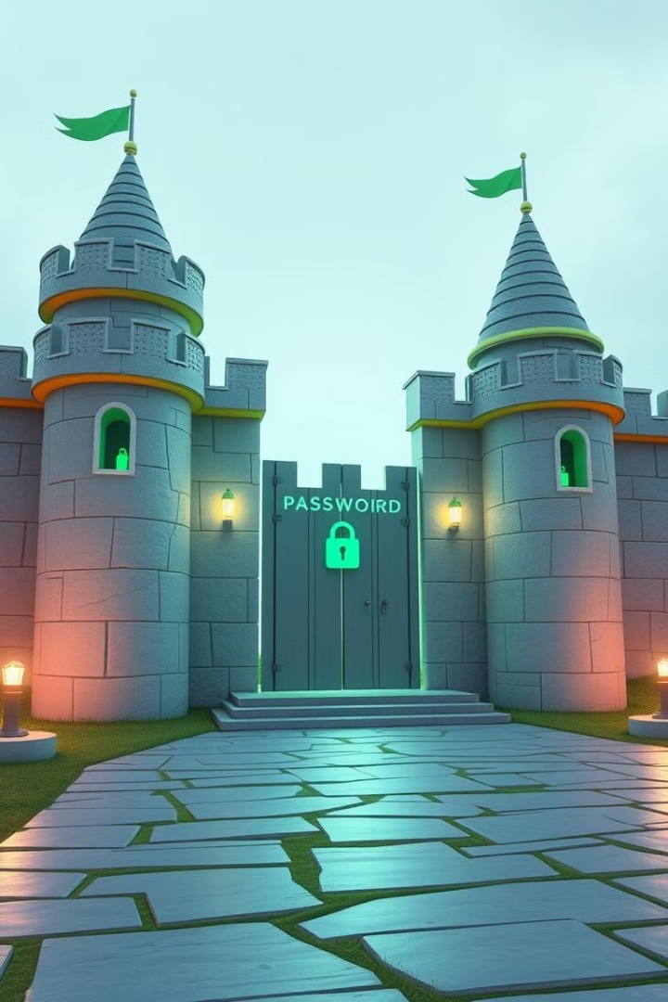
Passwords: The First Line of Defense
Create strong passwords. Use at least 12 characters with a mix of upper/lower case, numbers, and symbols. Avoid personal info such as birthdays, names, or addresses.
Password Managers
Use password managers like LastPass or 1Password. Remember ONE strong password!
Example
Instead of "password123", try "Tr!ckyK0alaL0v3sTacos!"
Did you know? 65% of people reuse passwords across multiple sites.

Slide 3
Two-Factor Authentication (2FA): Double the Security
2FA adds a second layer of verification, like a code sent to your phone. Enable it in the "Security" or "Privacy" settings of your social media accounts.
Options
Why it matters
Authenticator apps (Google Authenticator, Authy)
Even if someone gets your password, they still need the second factor. 2FA blocks 99.9% of automated bot attacks.
SMS codes

Slide 4
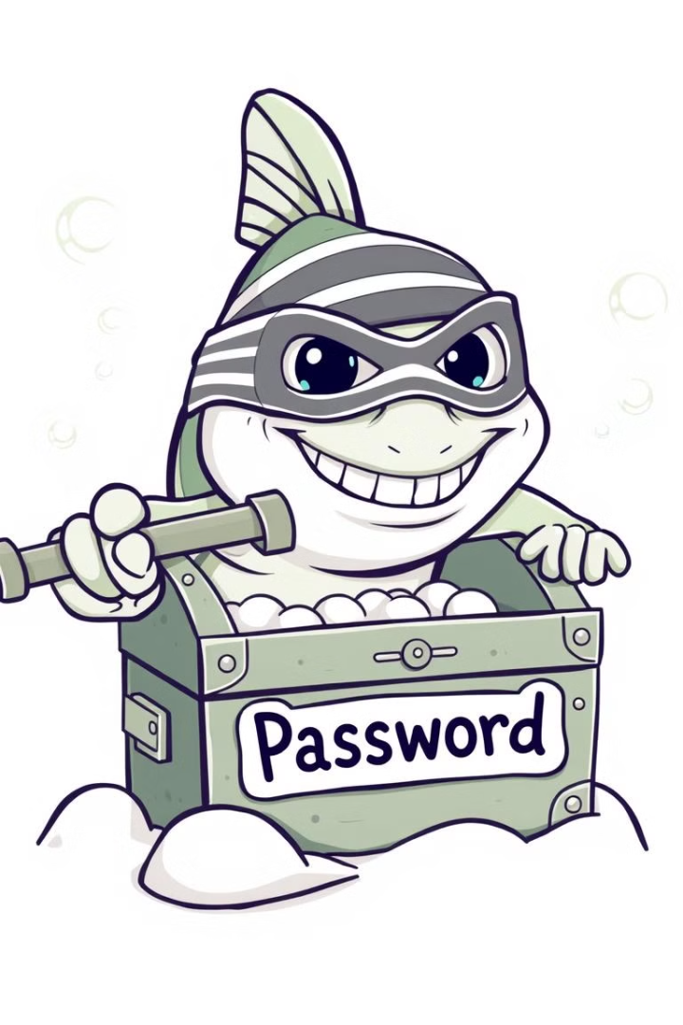
Spotting Phishing Scams
Phishing scams use fake emails, messages, or websites to steal your info. Watch out for urgent requests, spelling errors, and suspicious links. Never share personal information.
Red Flags
Be alert to urgent requests, spelling errors, suspicious links, asking for personal info.
Verify
Go directly to the website instead of clicking links.
Remember to report phishing attempts to the social media platform. 76% of businesses reported being a victim of phishing attacks in 2023.

Slide 5
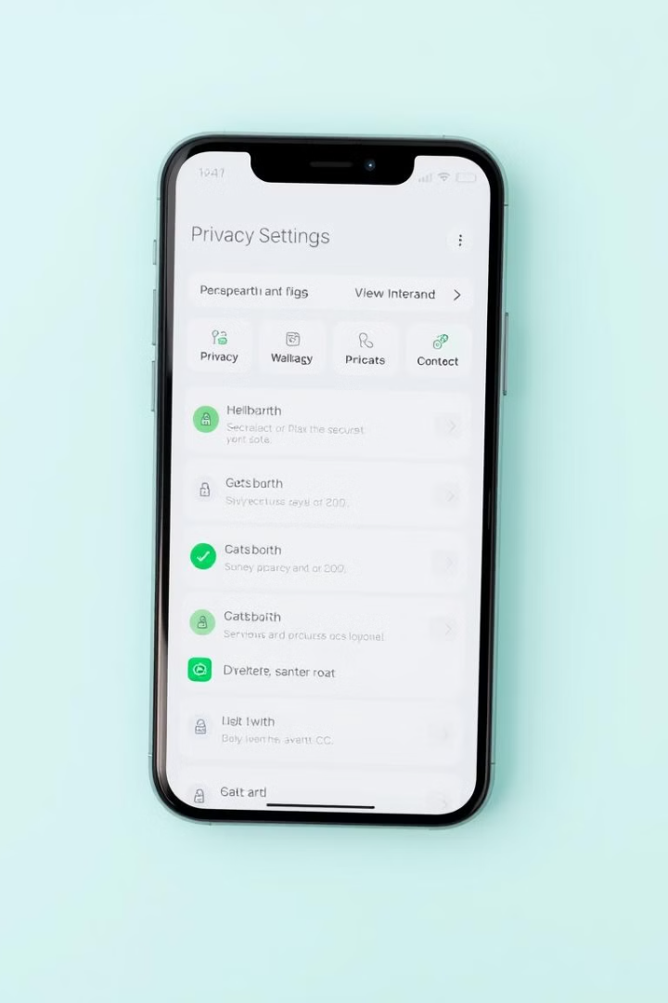
Privacy Settings: Control Your Information
Review your privacy settings. Control who can see your posts, profile, and friends list. Limit your audience to "Friends only" or custom lists instead of "Public."
Control Tagging
Location Services
Approve or deny tags before they appear on your profile.
Disable location sharing or only allow it for specific apps.
Data Sharing
Understand what information apps collect and how it's used.
Adjusting privacy settings can reduce unwanted contact by up to 80%.

Slide 6
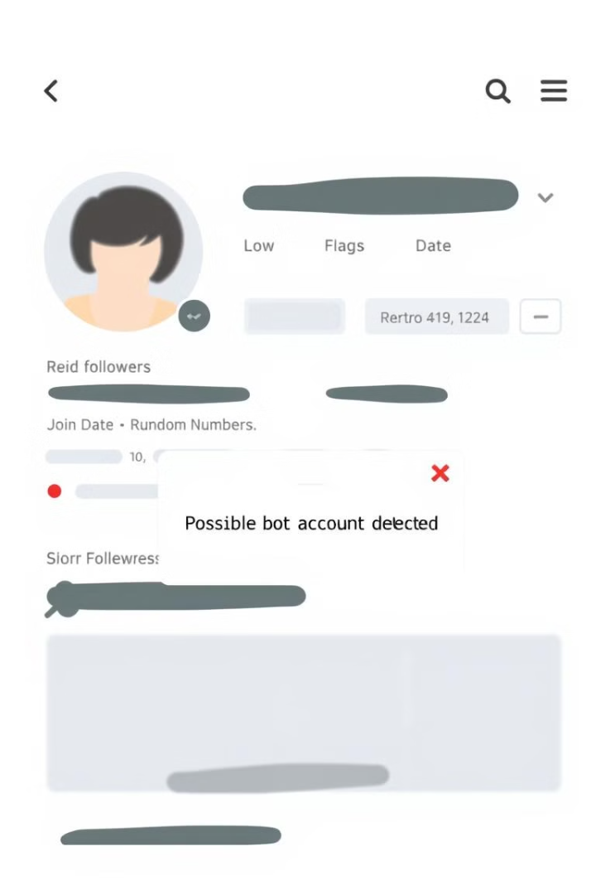



Recognizing Fake Accounts
Look for fake accounts. They often lack a profile picture, have few posts, and display generic information. Be wary of friend requests from people you don't know.
Reverse image search
Check if the profile picture is stolen from another website.
Suspicious Activity
Be alert if the profile has no mutual friends.
Report
Report fake accounts to the social media platform.

Slide 7




Avoiding Clickbait and Scams
Clickbait uses sensational headlines to lure you to fake or malicious websites. Watch out for overly dramatic language, unbelievable claims, and poor grammar. Verify the source.
Verify
Avoid
Think
Don't fall for fake giveaways, free offers, or miracle cures. Clickbait is 3X more likely to spread misinformation.

Slide 8
Secure Browsing Habits
Develop secure browsing habits. Use HTTPS by looking for the padlock icon. Keep your software updated and be careful what you download.
Software Updates
Downloads
Install security updates for your browser and operating system.
Avoid downloading files from untrusted sources.
Use a VPN to encrypt your internet traffic, especially on public Wi-Fi. Public Wi-Fi increases the risk of hacking by 70%.

Slide 9



Staying Safe on Public Wi-Fi
Avoid logging into sensitive accounts like banking, email, or social media on public Wi-Fi. Use a VPN to encrypt your internet traffic.
VPN
1
Encrypt traffic
HTTPS
2
Check website
Firewall
3
Enable it

Slide 10



Stay Vigilant, Stay Safe!
Security is an ongoing process, not a one-time fix. Regularly review your settings and passwords. Stay informed about the latest scams and threats.
Inform
2
Stay updated
Review
1
Check Settings
3
Share
Help others
Share this information with your friends and family. Your online safety is in your hands!

